Slide 1
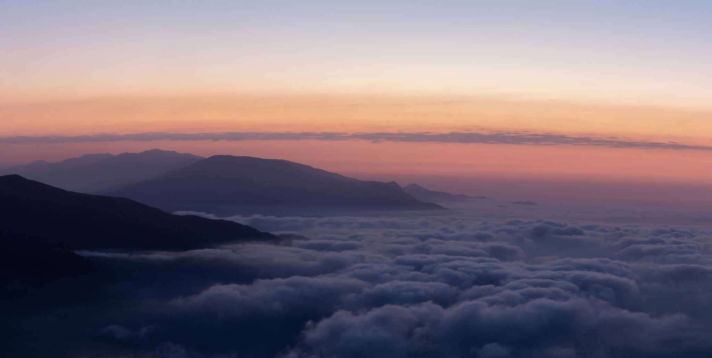
黃柏碩 Ryan Huang

Slide 2
Education Background
National Taiwan University Master degree, Physics
National Cheng Kung University Bachelor degree, Physics
Taipei Municipal Chenggong High School High school degree

Slide 3
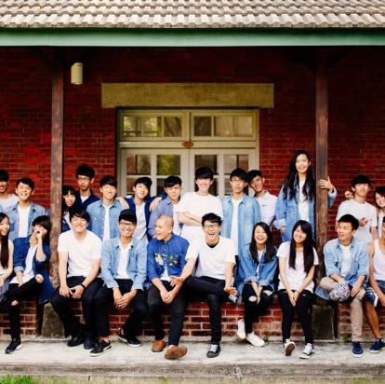
Director of pop dance club
---leadership
---team work
---friendship

Slide 4
Body Performance
Kaggle dataset

Slide 5
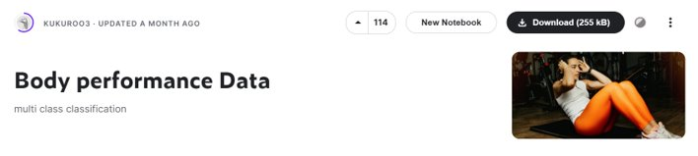
Data
From kaggle.com
Data shape(row data = 13393, features = 12)
Features: Age, gender, height, weight, body fat_%, diastolic (blood pressure), systolic (blood pressure), grip force, sit and band forward, sit-ups counts, broad jump
Class: A, B, C, D (A is the best)

Slide 6
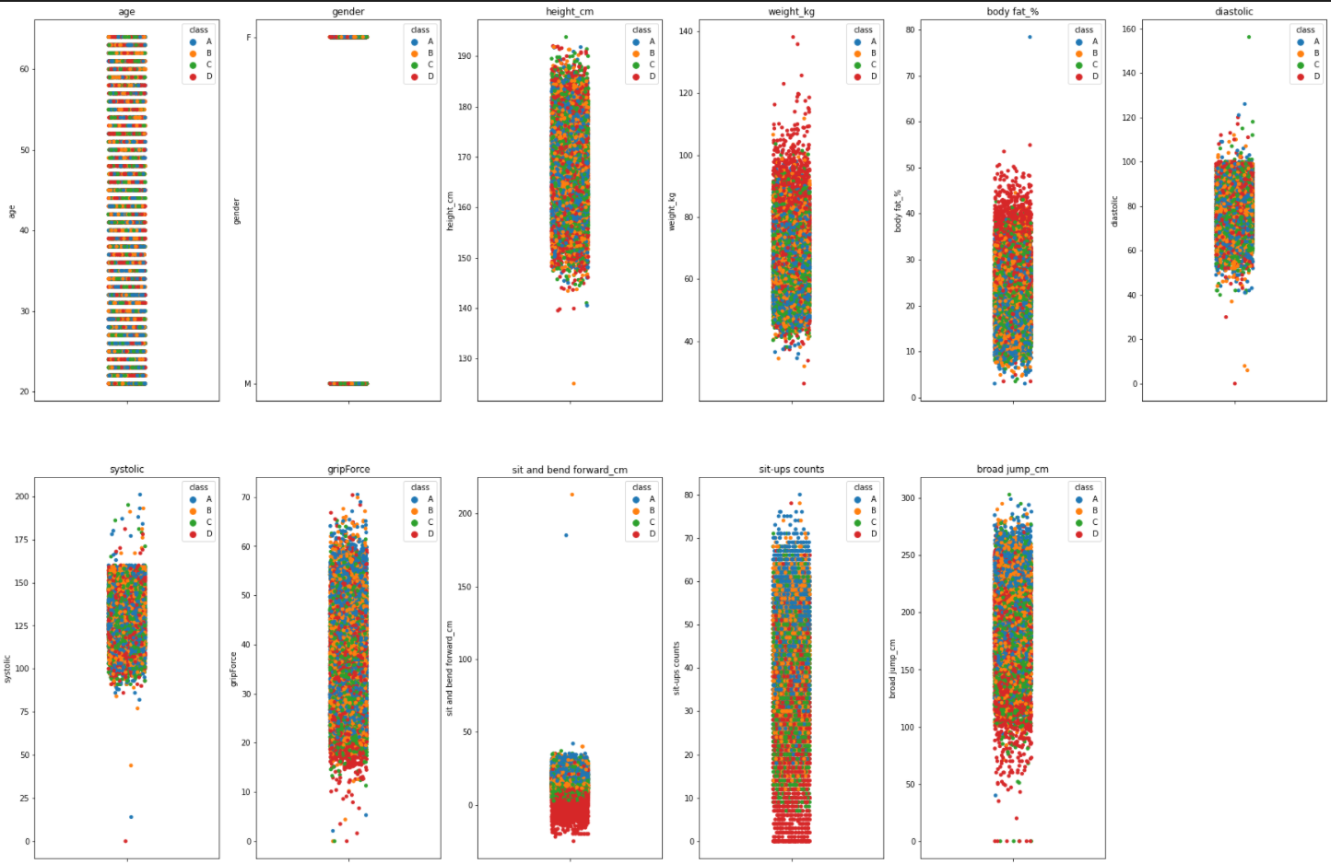
Feature Engineering
No missing data
Vectorize the 'gender'
Outlier detection(iqr)
Generate new features
Standardize the data
Eliminate high correlation features(0.8)
Present in stripplot form
按一下以新增字

Slide 7
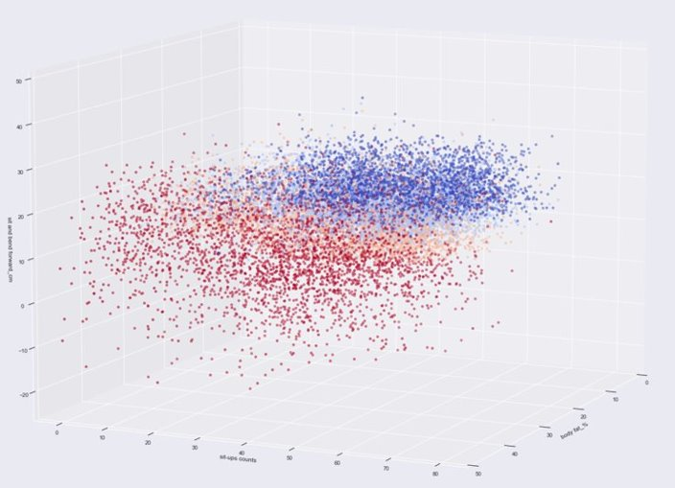
Correlation between top 3 features ---sit and bend forward ---sit ups counts ---body fat

Slide 8
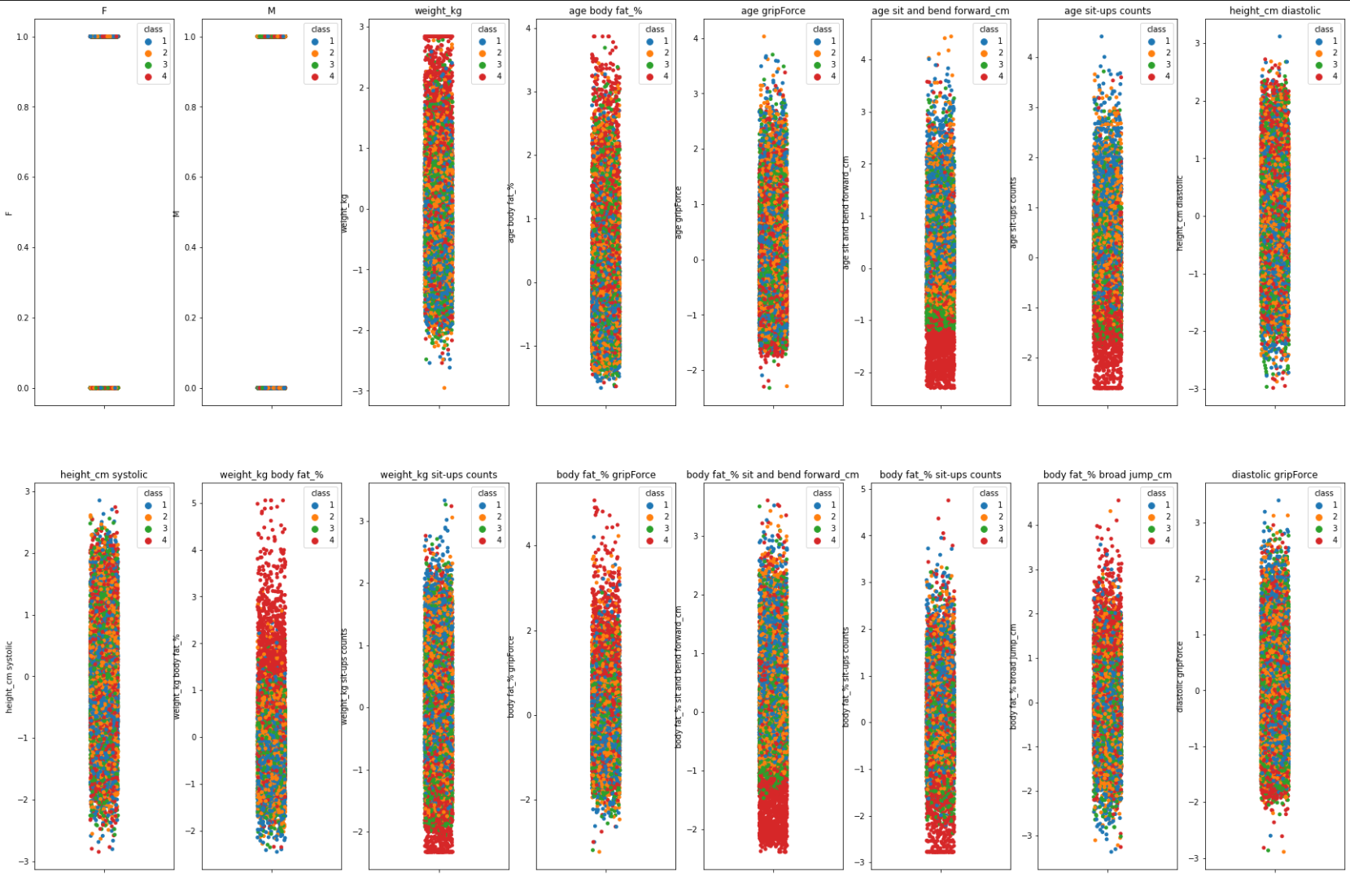
"New" features
Generate by "PolynomialFeatures" with interaction_only
Eliminate by correlation threshold=0.8 and choosen by highset correlation with "class"
Most Original features have been eliminate
按一下以新增字

Slide 9
Models
Logistic regression
KNN
Decision Tree
Random Forest

Slide 10
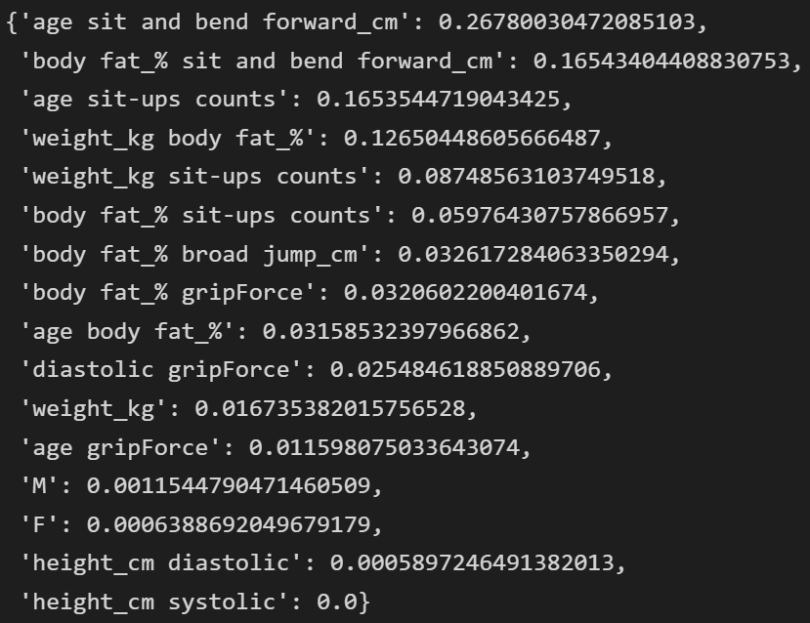
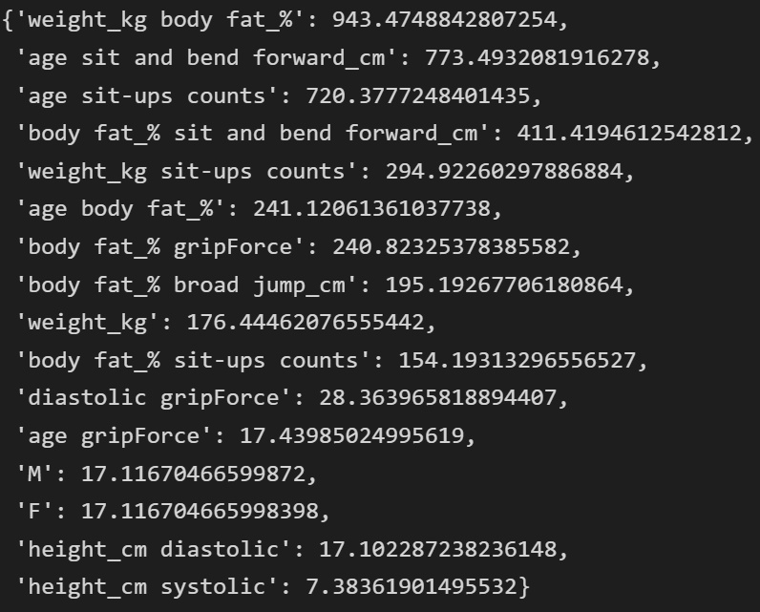
Feature Selection
fs.SelectKBest() : method to select the best features that relate to the result.
Score_func : fs.mutual_info_classif, fs.f_classif(ANOVA)
Scores_ : we can check the score to determine which feature are most important.

Slide 11
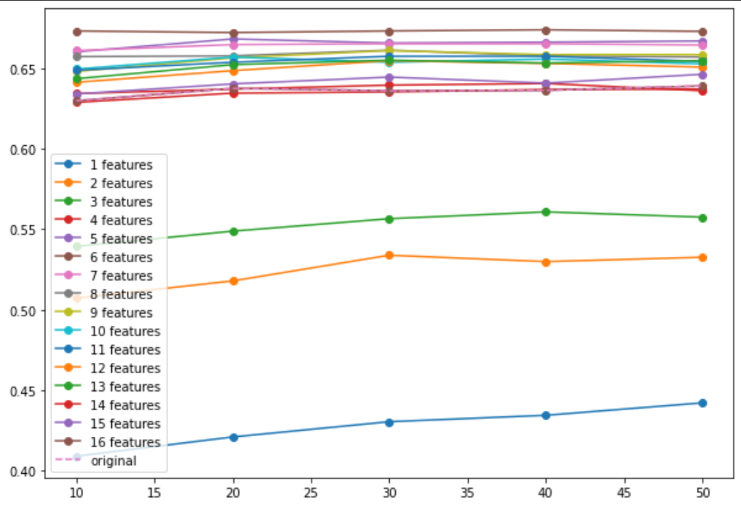
Feature Selection---KNN increase best
KNN model increase most under the feature selection.
The best numbers of neighbors in KNN slightly change.
Random Forest still hold the best performance.

Slide 12
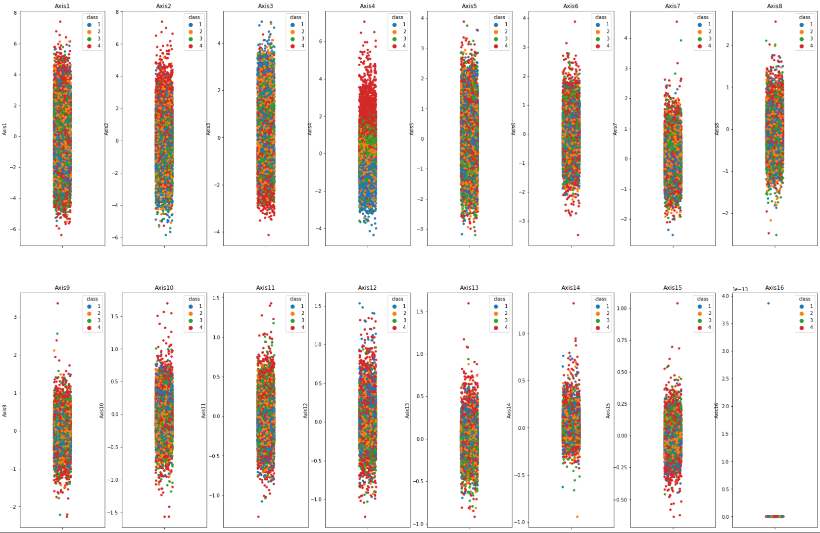
PCA—not so well

Slide 13
Conclusion
The model that had the best performance is Random Forest.
The model that increase most after the feature-selection is KNN.
The model had many noise data.

Slide 14
STAS Detection of Lung Adenocarcinoma
Online competition

Slide 15
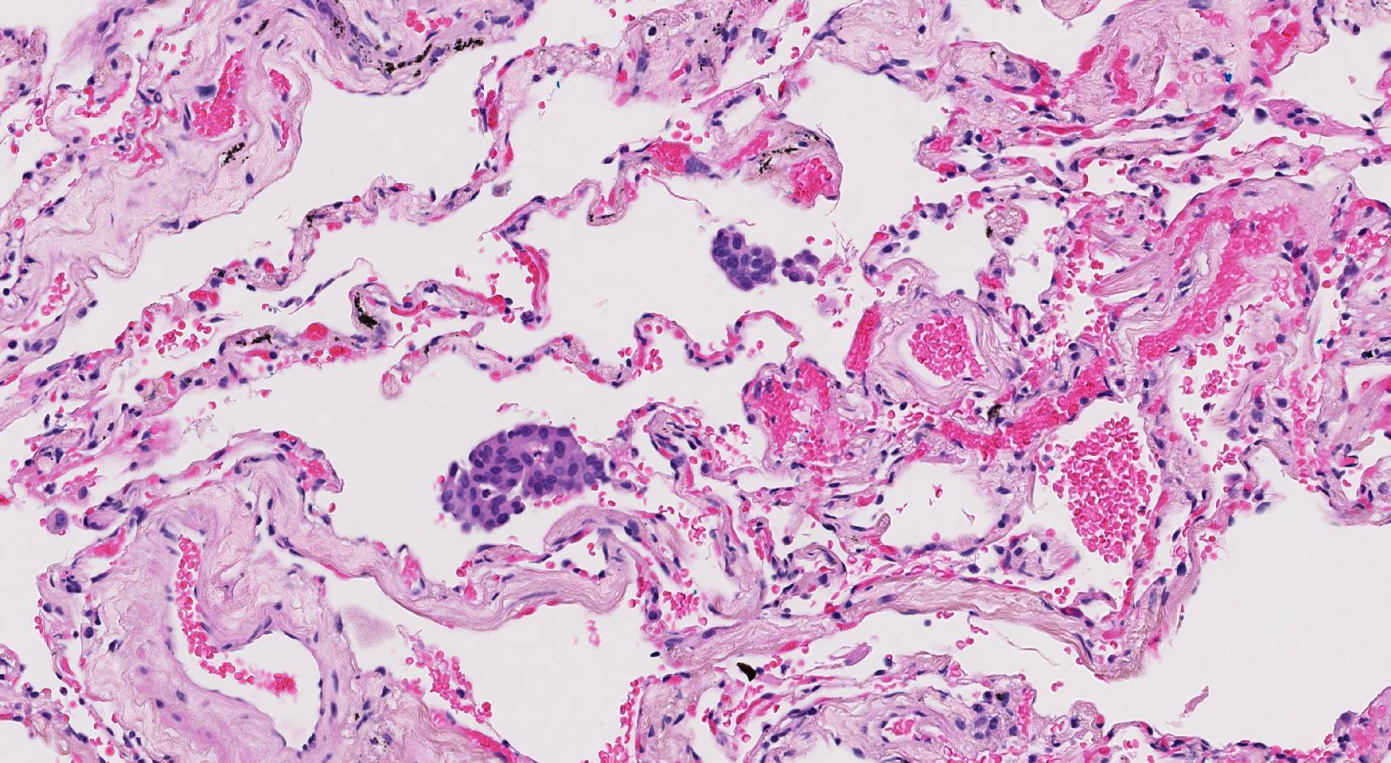
Data
STAS(spread through air spaces) of lung adenocarcinoma
1053 slice images of lung
Image size:1716*942
Corresponding lable files
Data split to train and val set(9:1)
Public testing set and private testing set

Slide 16

Model and Environment
Yolov5---object detection model
High Accuracy
Very fast
Weights and Biases---Visualize training metrics and losses
Connect with colab
Dynamic adjust with training process
Colab---online environement for python and GPU
Free online resource of gpu
Easy to share and collaborate

Slide 17
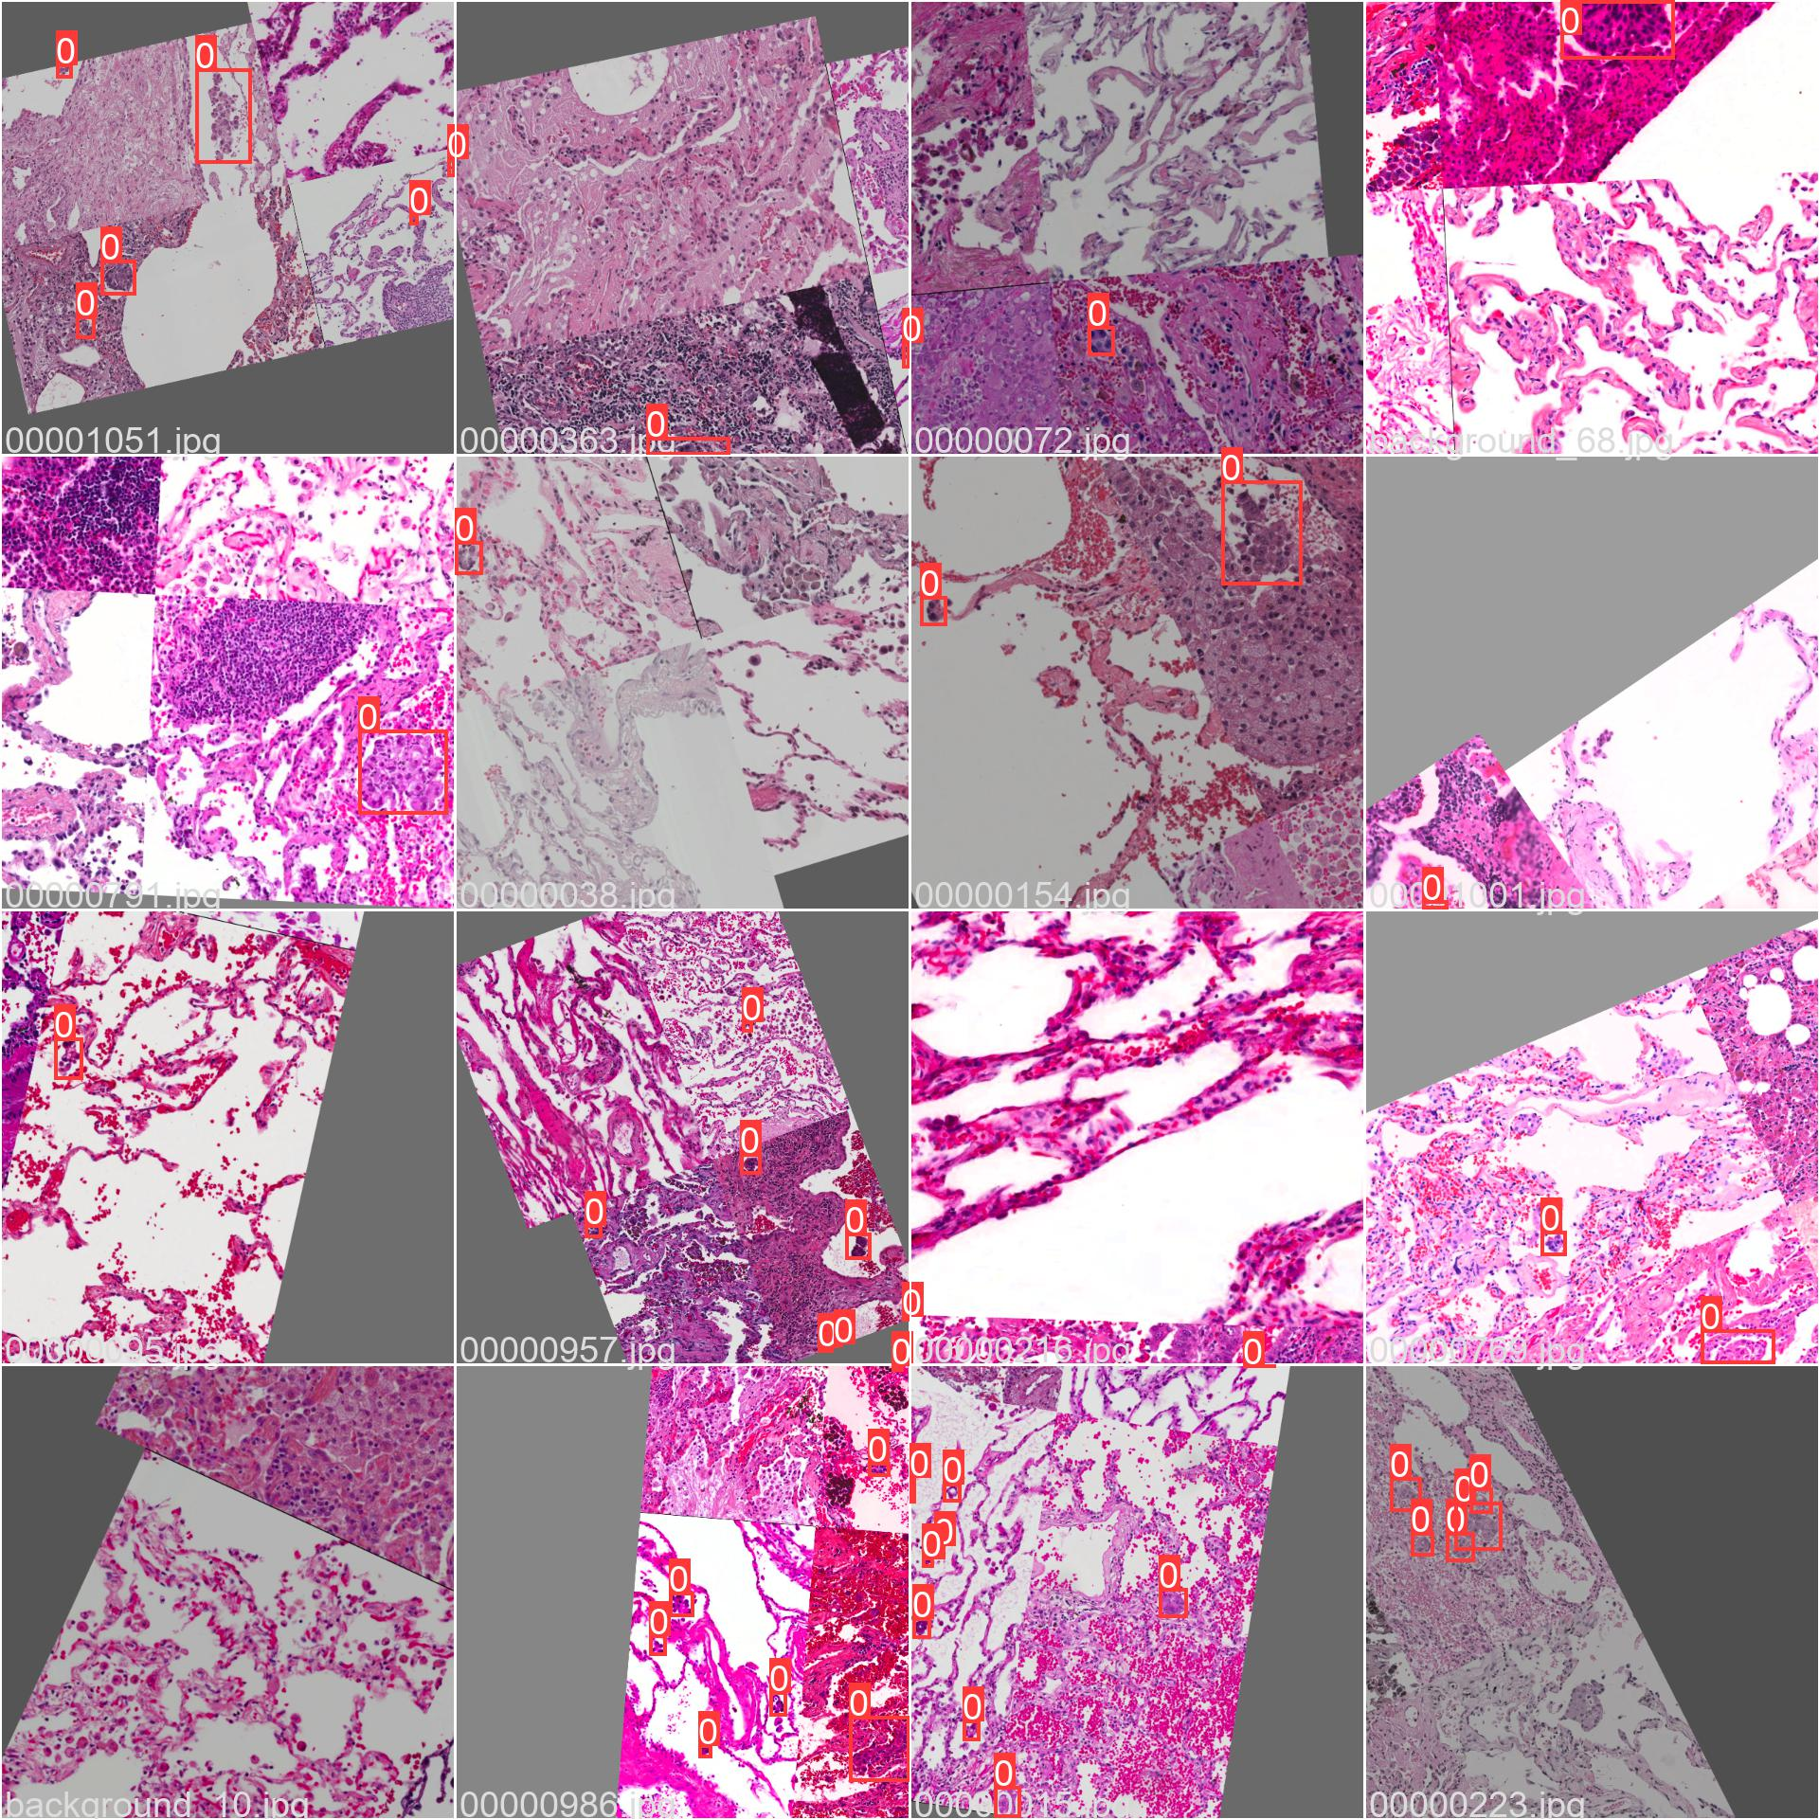
Preprocessing
Augmentation
Rotation---our objects are not affected by angle
Flipping---our objects are not affected by direction
excetra
Background
Generate by the original image
No labels in those area

Slide 18
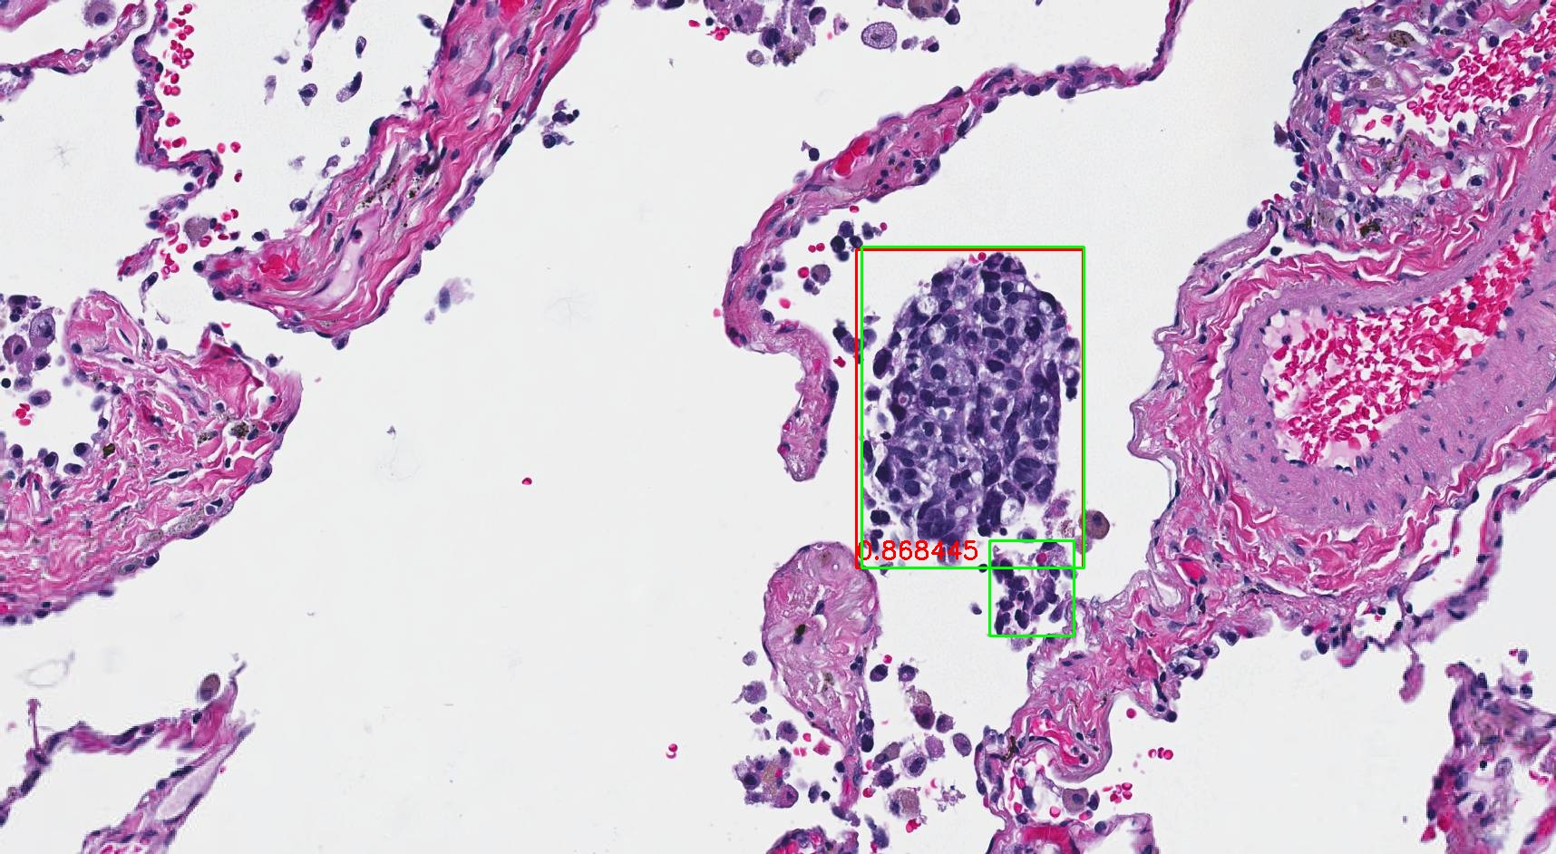
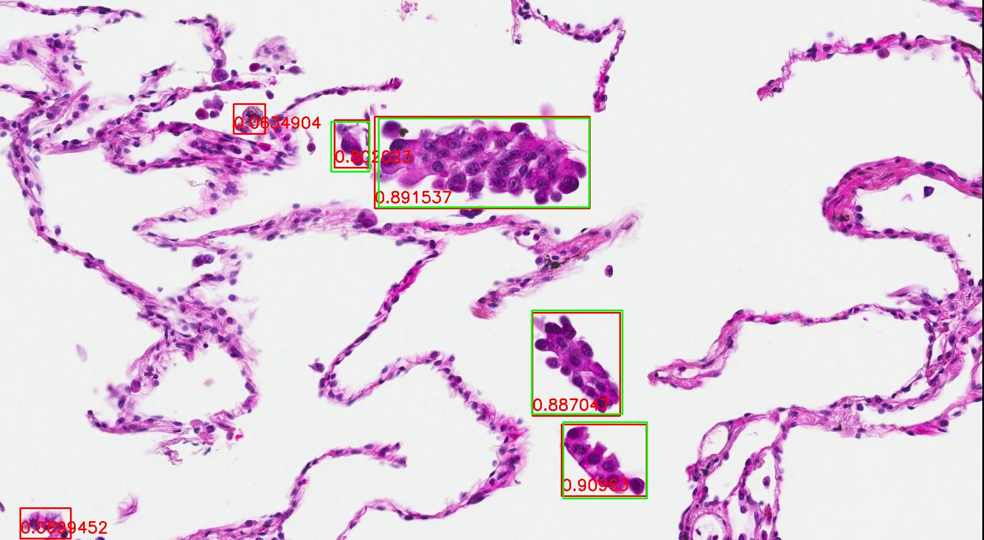
Validation

Slide 19
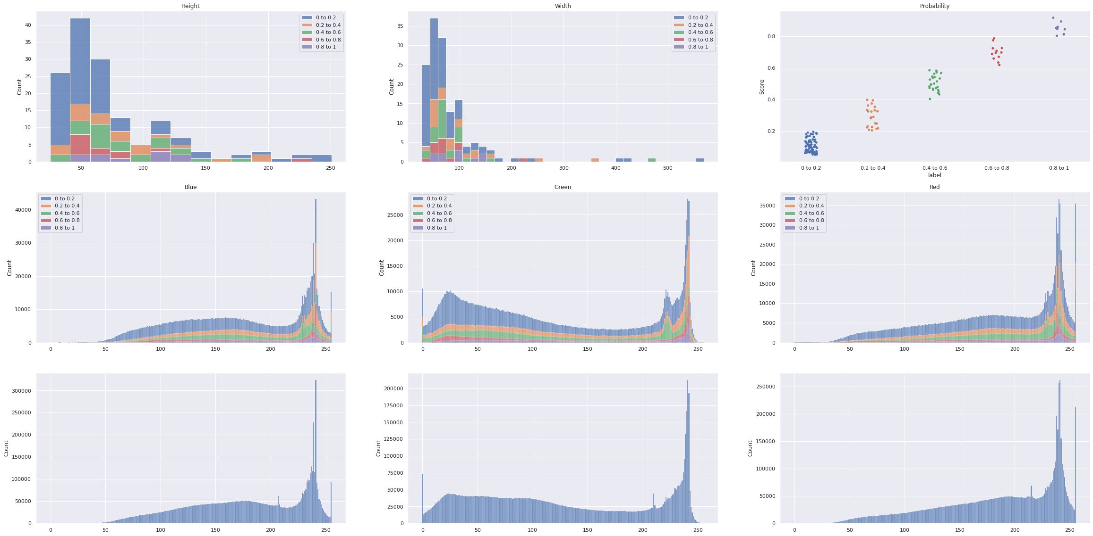
Error Analysis
Statistics of false-positive and false-negative(by IOU)
High and Width
BGR distribution
Probability distribution
Visualize the false-positive in different score

Slide 20
Thank you!!

